Slide 1
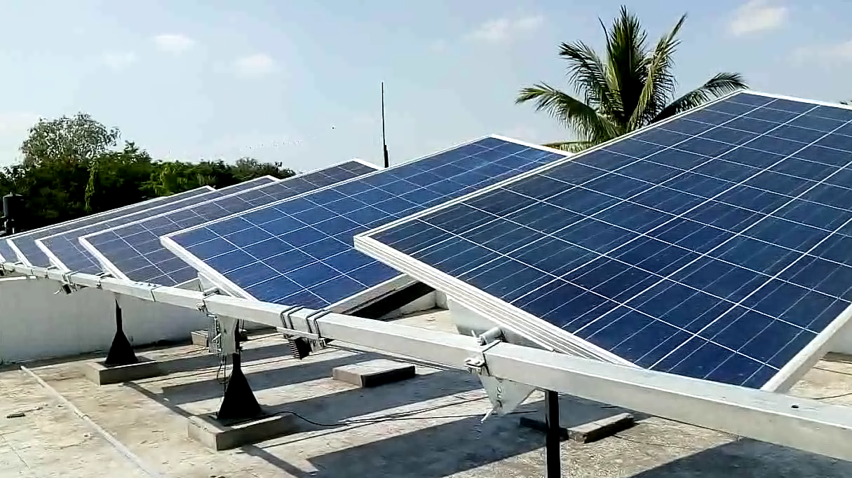
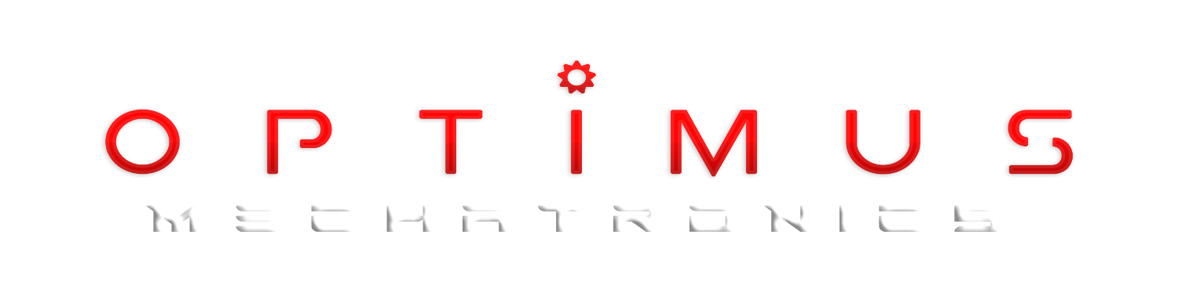

Slide 2
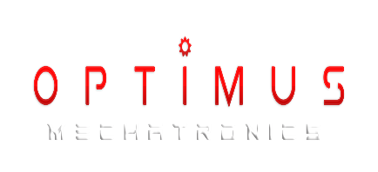

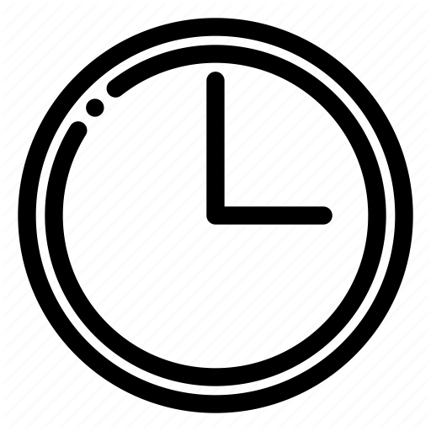
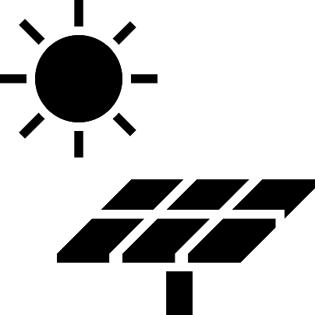
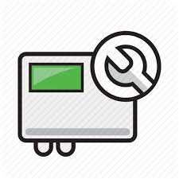

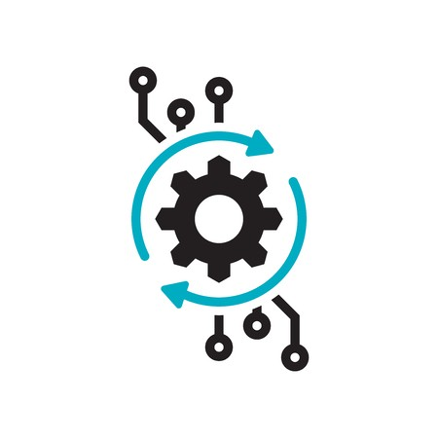
Benefits
Reduces labor
Reduces installation time
Reduces Solar Panels
Reduces inverter size
Reduces Capex and Increases Margins for installation companies
Uses Algorithms instead of sensors to track

Slide 3
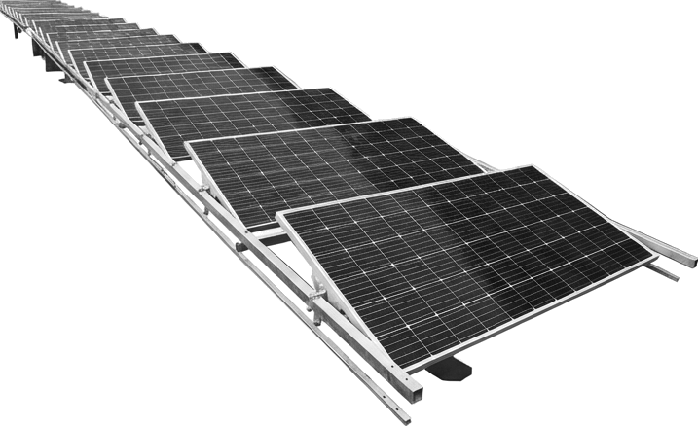
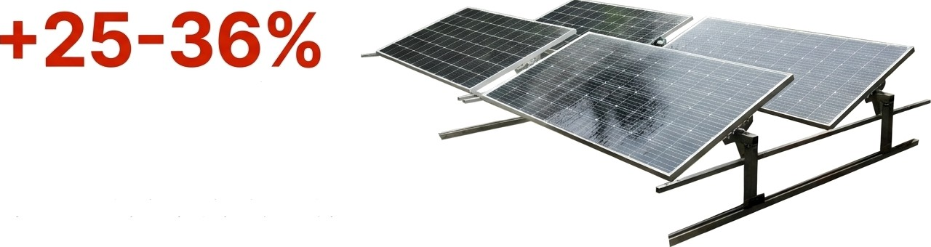

Our Product:
Dual Axis Rail Tracker
more energy generation.
Core Technology
The dual-axis movement tracks the sun's daily east-to-west path and seasonal north-to-south
adjustments, ensuring optimal orientation at all times.
Ideal Applications
Ground-mounted solar farms
Commercial flat RCC roofs
Large-scale utility projects

Slide 4
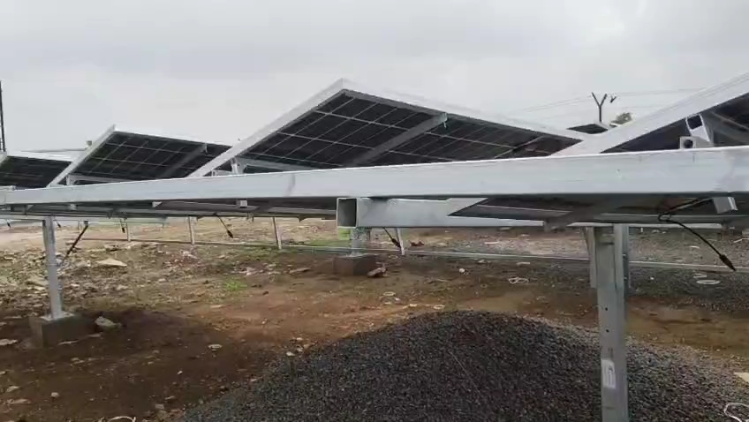
Working Principle

Slide 5

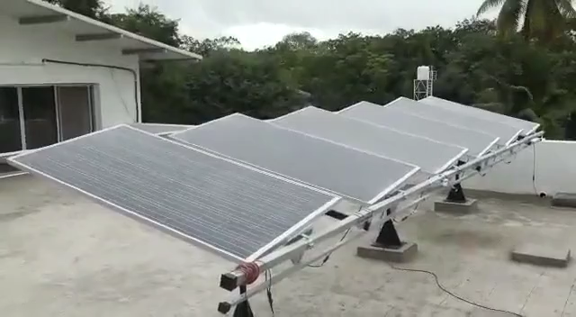

Slide 6
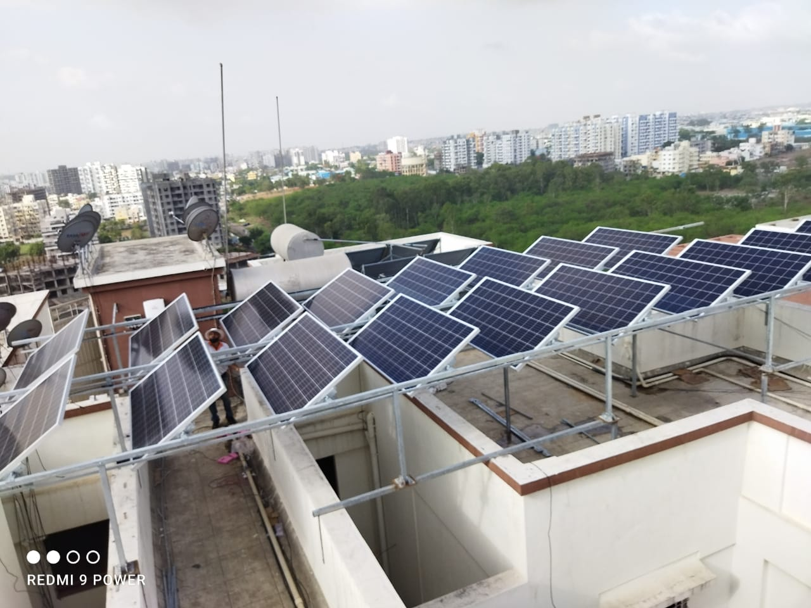

Slide 7
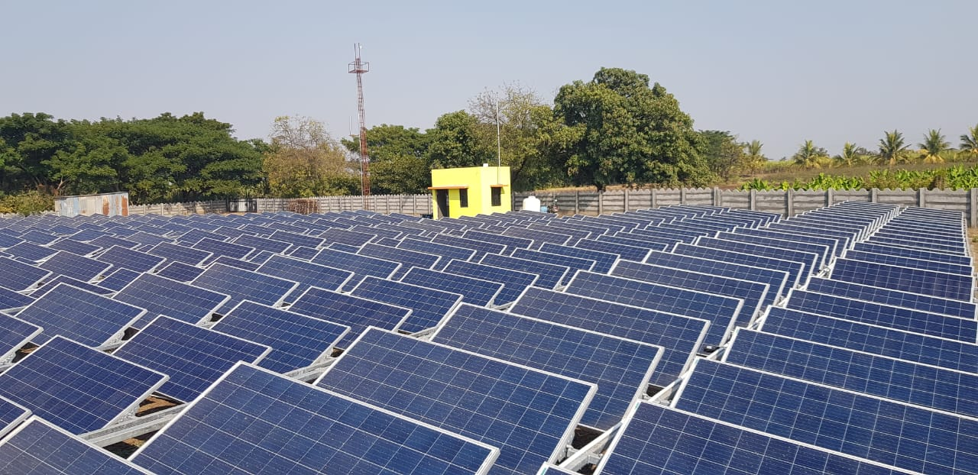

Slide 8
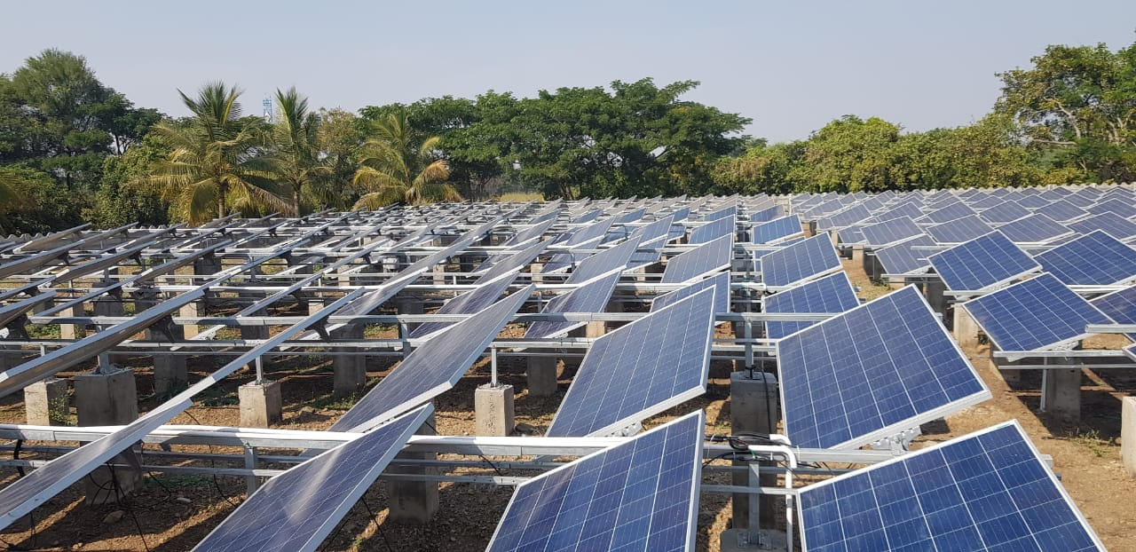

Slide 9


Slide 11
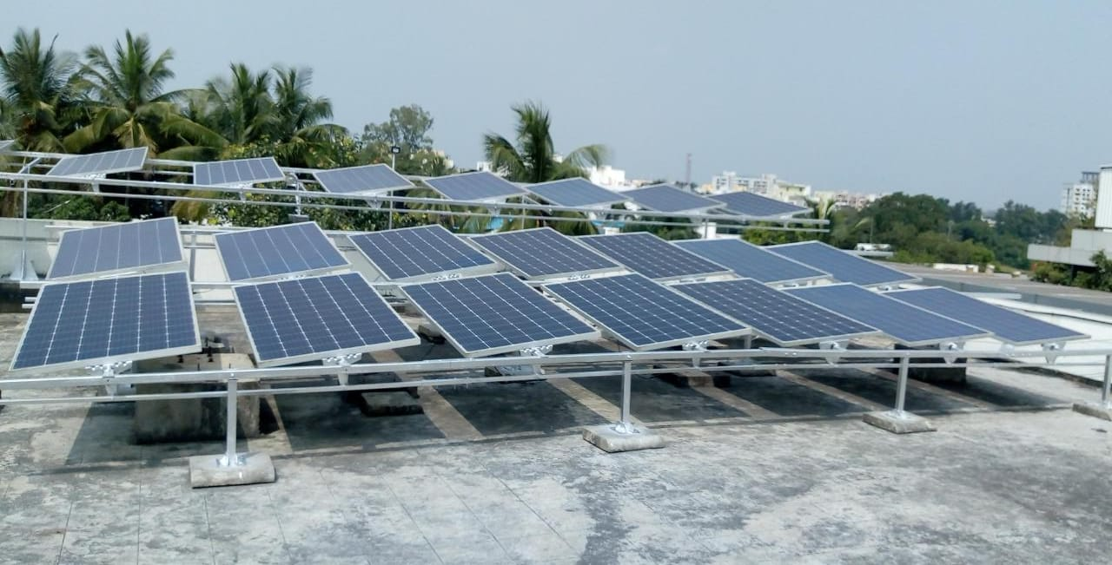

Slide 12
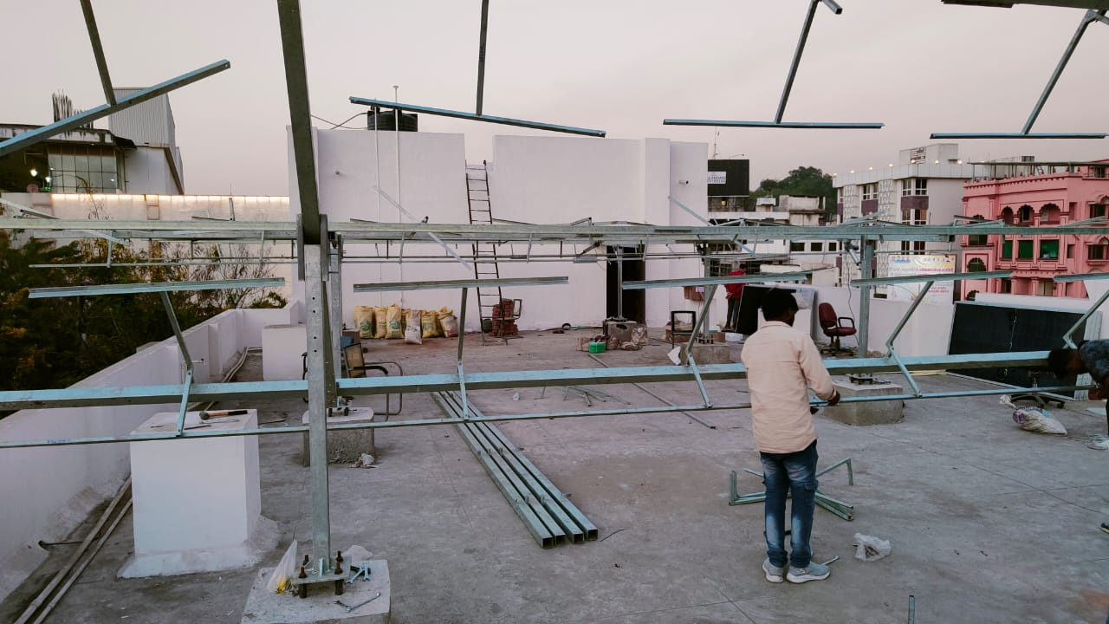
MSRDC Office, Nagpur

Slide 13
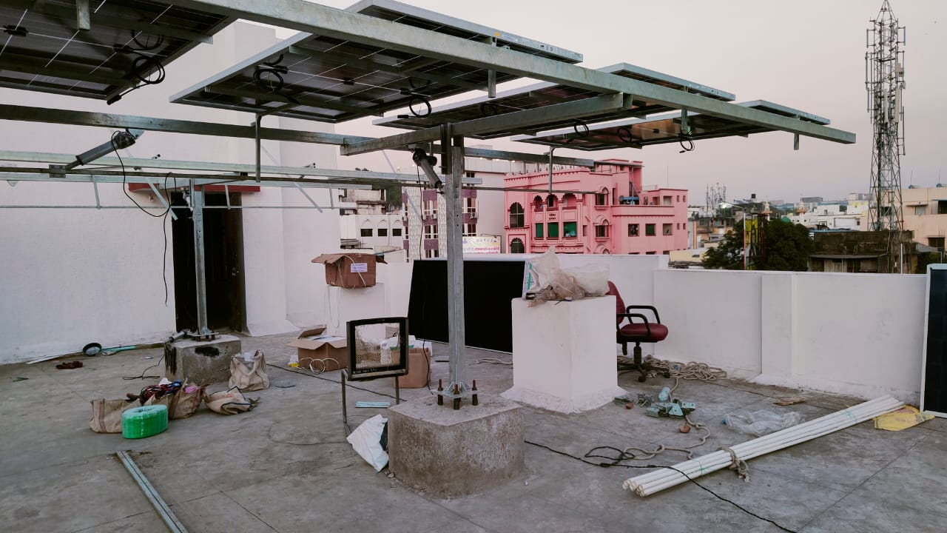

Slide 14
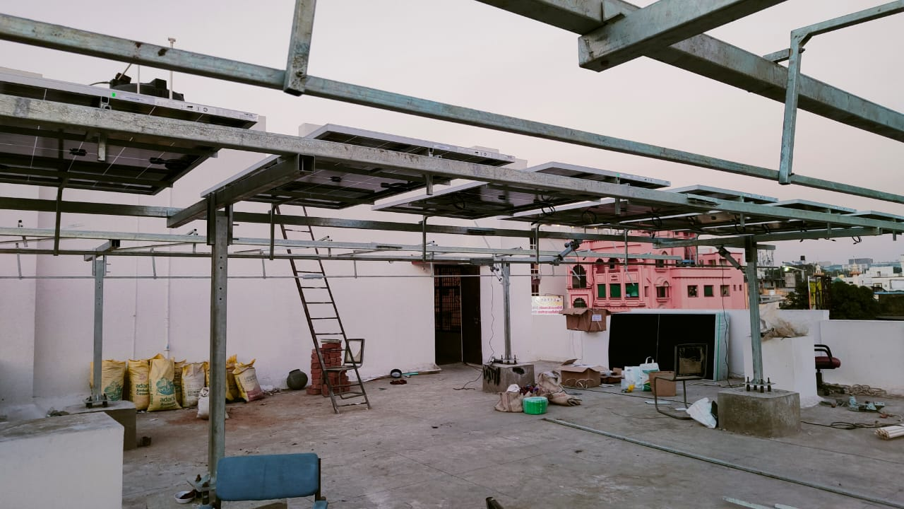

Slide 15
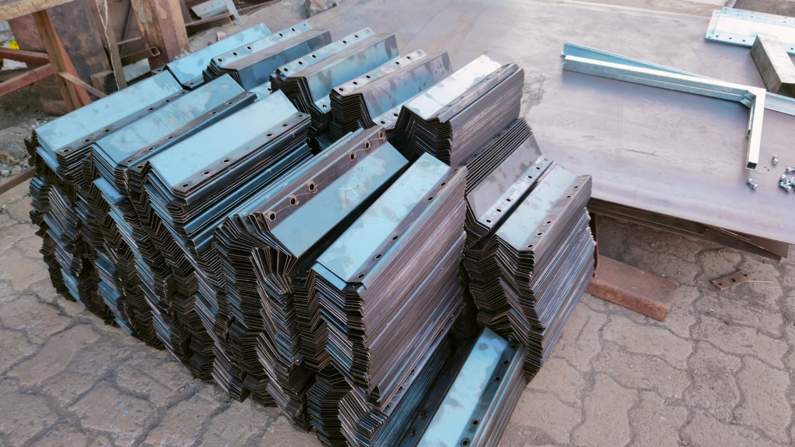
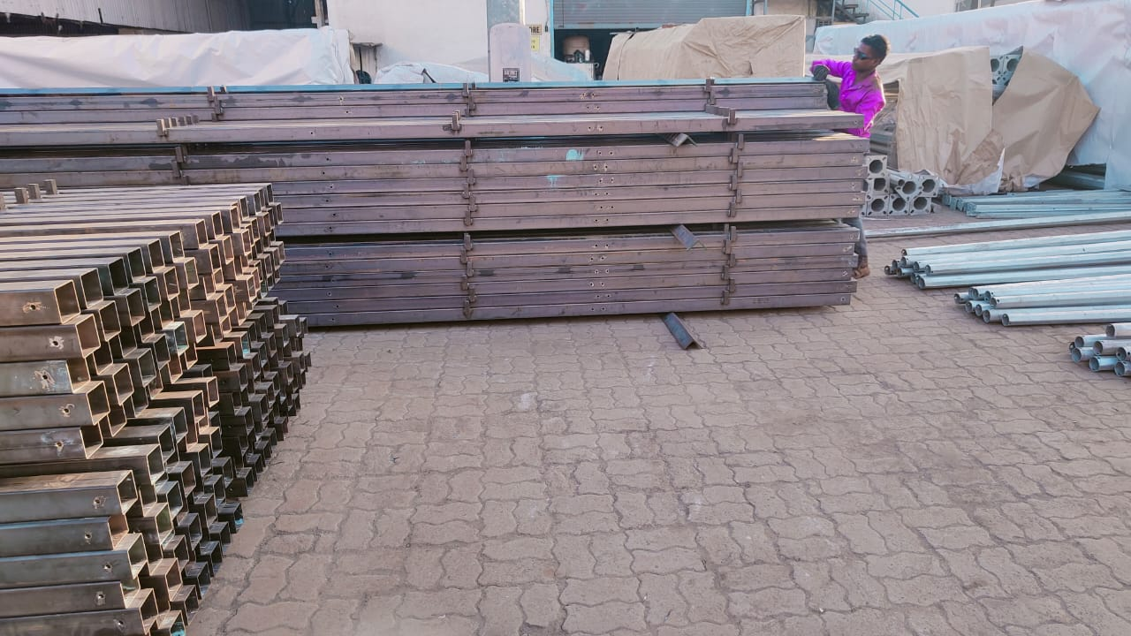
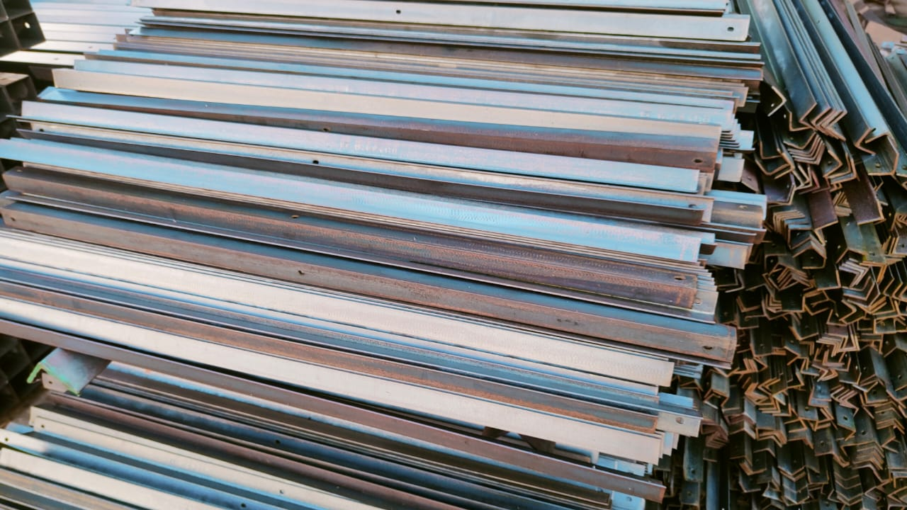
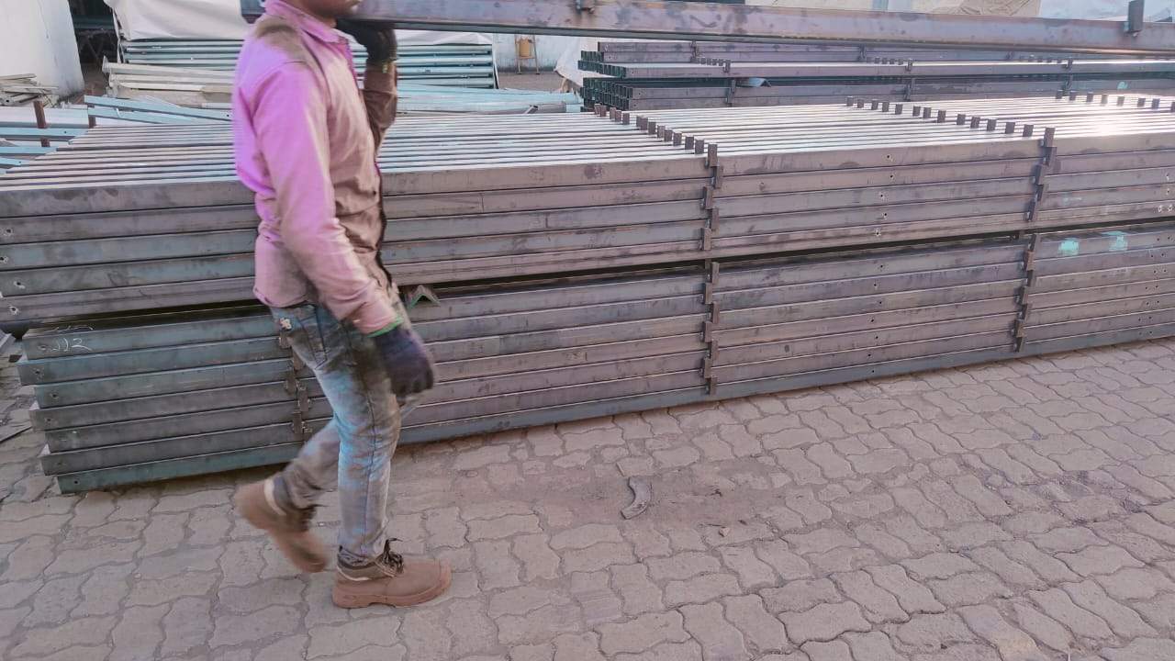
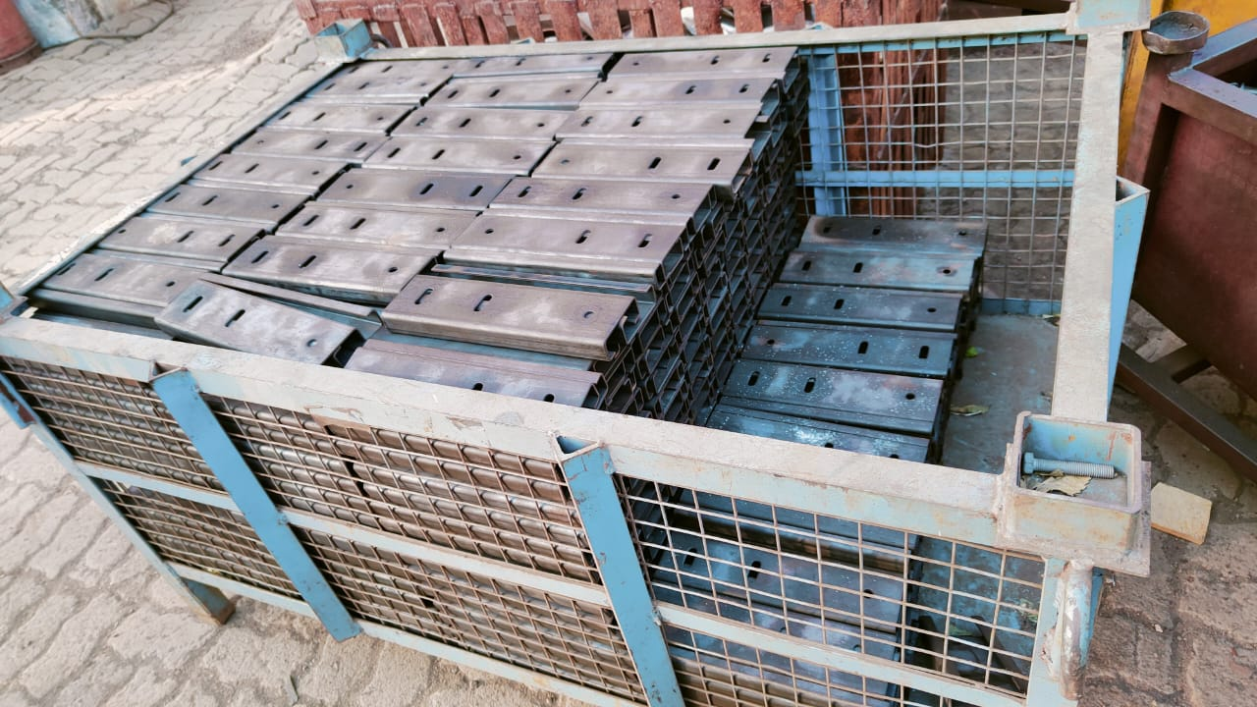
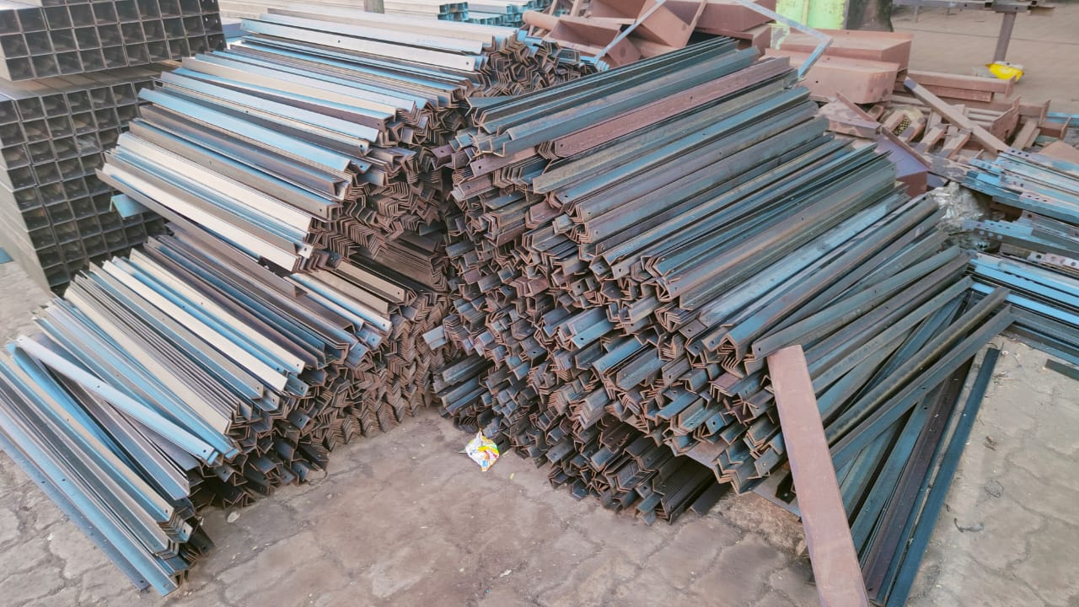
Structure Manufacturing

Slide 16
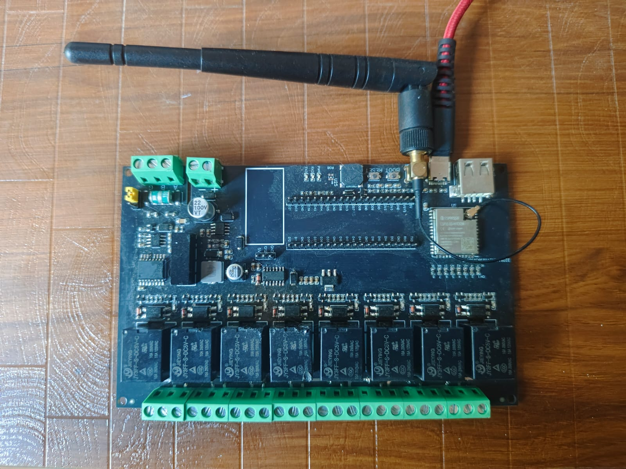
Indigenously developed solar tracking controller

Slide 17
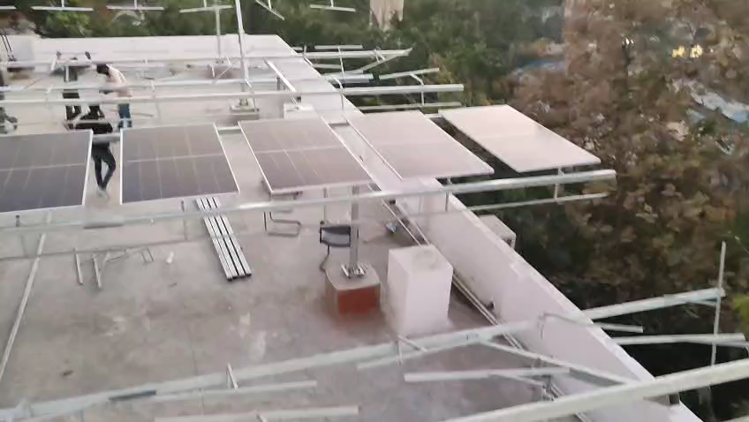

Slide 18
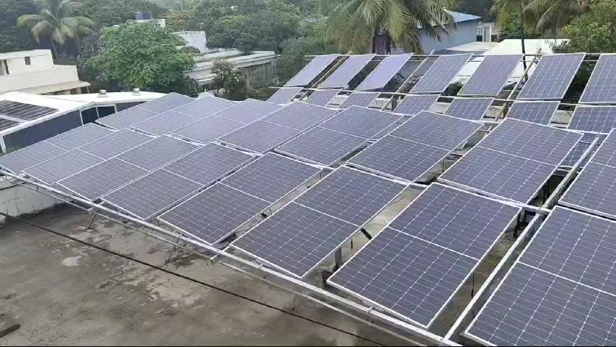

Slide 19







Engineered for Performance and Reliability
Solar Tracking
Method
Patented Sun tracking algorithm using time to calculate the sun's position. No analog or digital sensors.
Server (AWS)
Tracking Accuracy
+/- 2 degrees.
Wind Speed Detection
Anemometer senses and re-positions the structure to a safe, aerodynamic stowing position during high winds.
Controller Motor
Diagnose, Reset, Calibrate,
Change locations, Stall, OTA
Trackers
Power Consumption
Less than 50 kWh/year.
Ingress Protection
IP65/67 rating.
Operational Range
-20 degrees to +80 degrees Celsius.
API
Onboard WiFi module communicates with central servers for diagnostics, resets, and calibration.
Remote Management
Server
Weather Station

Slide 20
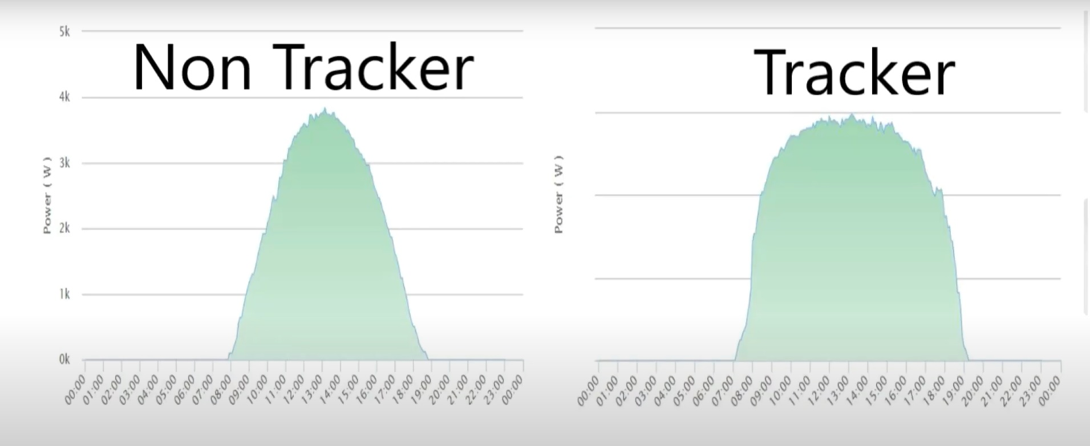
Solution
Advantage
Electricity generation graph comparison

Slide 21
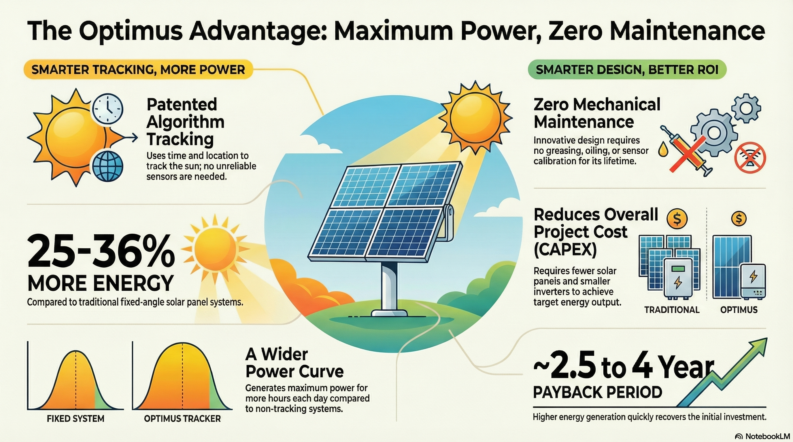
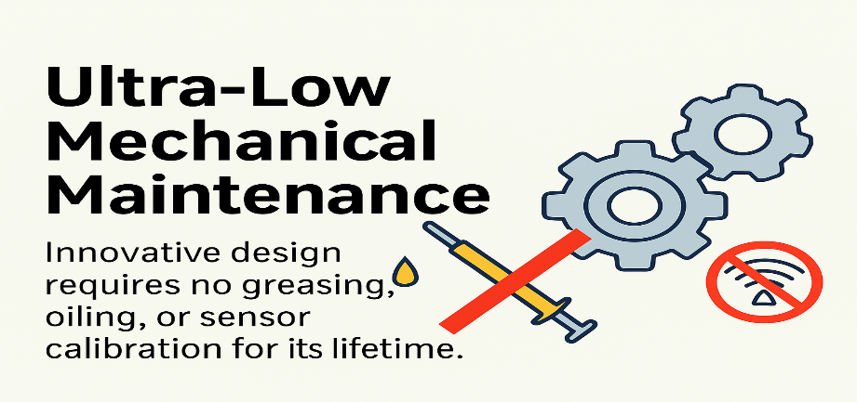

Slide 22
